Slide 1

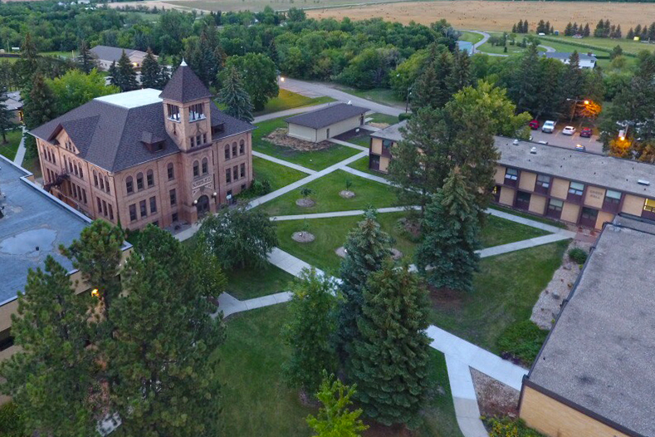

New Employee
Orientation
Health Benefits
- Office of Human Resources -
2023-2024

Slide 2

Welcome to Dakota College at Bottineau
Dakota College at Bottineau takes pride in the student experience through a supportive relationship with dedicated faculty and staff. We are student-focused and community-centered and value integrity, engagement, inclusion, and passion.
Dakota College at Bottineau is an affiliate of Minot State University.
Dakota College at Bottineau provides a quality education in a caring environment.
We adapt to the changing educational landscape to empower students and impact communities.
DCB Lumberjack Logo

Slide 3
DCB Benefits Package
Dakota College at Bottineau (DCB) is proud to offer a comprehensive benefits package designed to meet the needs of employees and their families. DCB offers fully paid family health insurance with a range of options for dental, vision, life insurance, disability, employee wellness, retirement/pension, tuition waivers, professional development programs and much more.
DCB’s benefits package is housed under the North Dakota Public Employees Retirement System (NDPERS). www.ndpers.gov/member-self-service-mss

Slide 4
Benefit Eligibility
DCB provides benefit-eligible employees a full package of benefits including medical, dental, vision, life, long-term disability and flexible spending account options.
Benefit eligible employees are those who meet the following requirements:
Working more than 20 hours per week for 20 weeks or more in a calendar year
Filling a regularly funded and approved position
When these conditions are met, an employee remains eligible for benefits for the full calendar year.
Benefited employee, spouse & dependents:
Must enroll within 31 days of employment or 31 days of involuntary loss of other health insurance or wait for open enrollment period
Dependents are covered until age 26
Married dependents are not eligible to enroll their spouse or children
If you are claimed as a dependent on someone else’s taxes, are covered by Medicare or a Flexible Spending Account, you are not eligible to enroll in a High Deductible Health Plan.
Health benefits begin on the first day of the month following the date of hire.

Slide 5

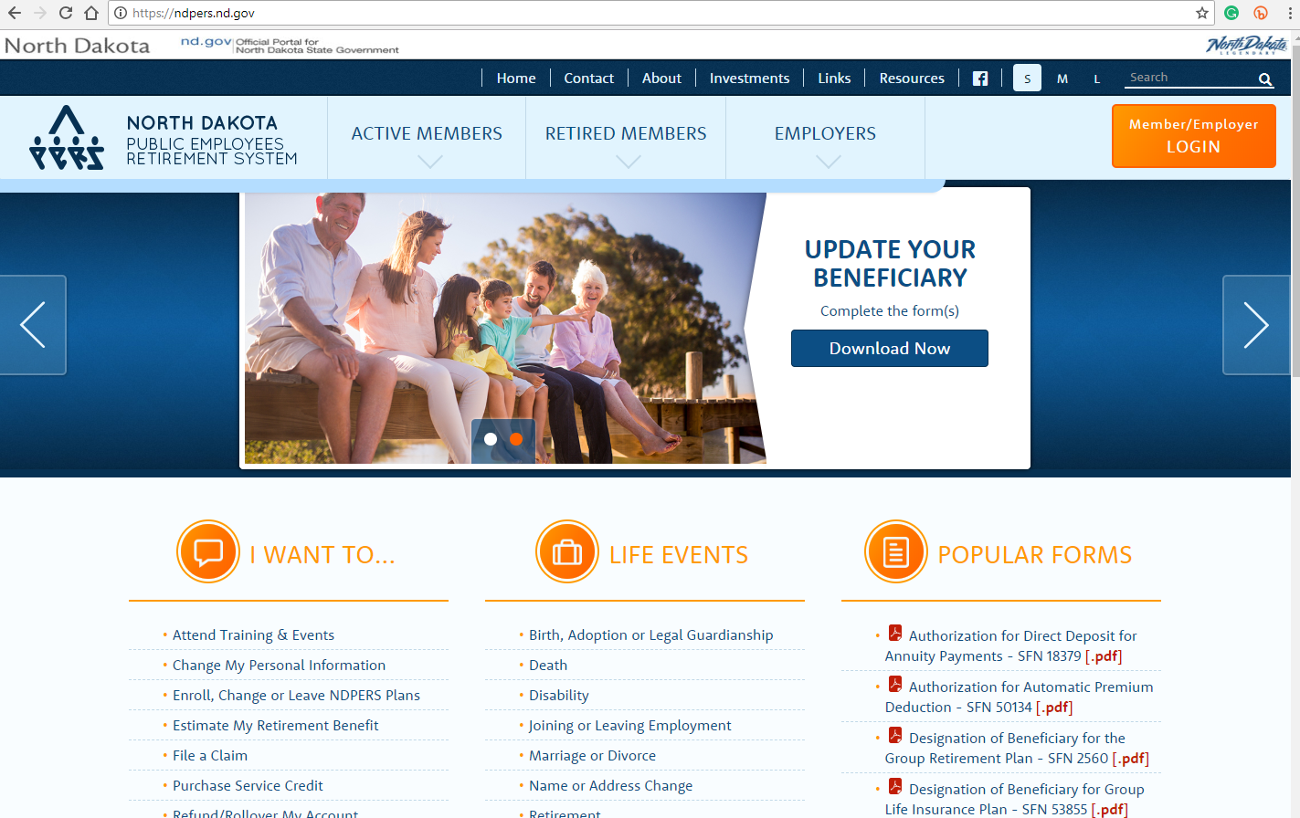

Benefit Registration
DCB benefit programs are administered by NDPERS (North Dakota Public Employees Retirement System). During your first week of employment, you will receive an email from NDPERS Member ID office with a link and temporary password for enrollment. (They will also send your login information via Mail)
Detailed benefit information is available at: www.nd.gov/ndpers
Click on the active member tab to review benefit options.

Slide 6
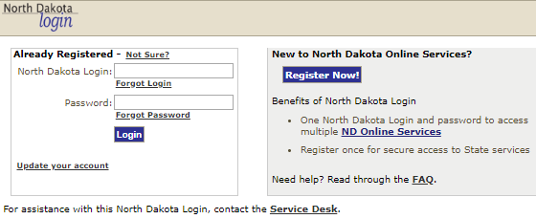
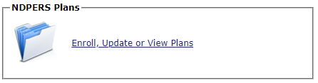
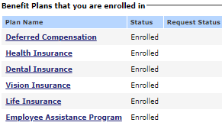
Benefit Registration
Welcome to the PERSLink Member Self Service (MSS).
NDPERS registration page
Select “NDPERS Plans”
When you have selected the plan you would like to enroll in, your status will change to “enrolled”.

Slide 7



Medical
Sanford Health is the medical carrier
DCB offers two medical care options:
  PPO/Basic (Dakota Plan)
  High Deductible Health Plan (HDHP)
    Health Savings Account (HSA)
Cards are mailed to the home address
The PPO/Basic plan is the most common plan with copays and in-network provider visits without referrals.
When an employee selects an HDHP, he/she incurs a higher deductible expense.
The premium paid by the university for the HDHP is lower, and the premium savings is contributed to a Healthcare Savings Account (HSA) for the employee to pay out-of-pocket medical expenses.
NDPERS will make monthly employer contributions for single coverage or for family coverage.
PPO/Basic Grandfathered Plan
High Deductible Health Plan (HDHP)

Slide 8

Health Savings Account (HSA)
A Health Savings Account (HSA) enables you to set aside pre-tax dollars to pay for qualified medical expenses for both individual and family.
Must be enrolled in the High Deductible Health Plan (HDHP)
Automatic enrollment with HDHP
Balances can be carried over from year to year
Additional contributions can be made to fund the account
If you are claimed as a dependent on someone else’s taxes, are covered by Medicare or a Flexible Spending Account, you are not eligible to enroll in a High Deductible Health Plan.
Coverage Type 2023 2024
Single HDHP Coverage $3,850 $4,150
Family HDHP Coverage $7,750 $8,300
Age 55+Catch-up $1,000 $1,000
Once you select HDHP coverage, Sanford Health, the HSA Plan Administrator, will send you information on how to make additional contributions, access your HSA account and how to submit claims for reimbursement.

Slide 9
Contact Information
Health insurance cards, coverage and claim questions
Contact Sanford Health at 800-499-3416
Sanford Member Portal: https://www.sanfordhealthplan.org/ndpers
DCB Payroll & Benefits Office: Marlene Hargrave
Available via email or Teams marlene.hargrave@dakotacollege.edu
OR
    Human Resources – Sandy Hageness
    DCB Thatcher Hall #111 | sandy.hageness@dakotacollege.edu
    701-228-5480

Slide 10
AFLAC
Cassie Loard, Independent Associate Address: 1370 20th Ave SW Minot ND 58701 Email: Cassandra_loard@us.Aflac.com Phone: 701-720-6287 or 800-992-3522

Slide 11

Dental Insurance
Dental Insurance for Active Members
Monthly Premiums Effective January 1, 2024
Level of Coverage Monthly Premium
Individual Only $41.00
Individual & Spouse $79.12
Individual & Child(ren) $91.86
Family $130.82
Covered Services | Plan Coverage | Coinsurance
Preventive and diagnostic | 100% | 0%
Oral Surgery | 80% after $50 deductible | 20%
Endodontics | 80% after $50 deductible | 20%
Major Restorative | 50% | 50%
Orthodontics | $1,500 Max. | 50%
For a complete list of covered services and limitations/exclusions, please refer to the Dental Benefit Plan Summary.
This form is filled out online through NDPERS
Contact Delta Dental for coverage questions at 1-800-448-3815

Slide 12

Dental Insurance
2024 Plan Year Premiums | Per Month
Employee Only | $39.20
Employee + 1 Dependent | $74.16
Employee +2 or more dependents | $123.60
The Advantages of our Elite Choice PPO Dental Plan:
No Annual Deductible in network
No Waiting Periods
$2,000 Annual Benefit Maximum
Affordable monthly Premiums
Large statewide PPO network
If you are deciding for the first time EMI Health dental plan is the right one for you, or if you need to add or delete dependents, or make any other changes to your dental insurance, please contact the Payroll Department.
Visit EMI Health website for more information

Slide 13

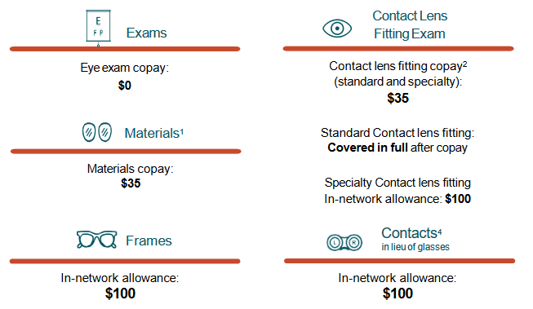
Vision Insurance
NDPERS Vision Summary
Monthly Premiums Effective January 1, 2024
Level of Coverage Premium
Individual Only $5.03
Individual & Spouse $10.06
Individual & Child(ren) $9.16
Family: employee,
spouse, & child(ren) $14.19
Contact Superior Vision for coverage questions at 1-800-507-3800

Slide 14

Flexible Spending Accounts (FSA)
Learn More
A Flexible Spending Account (FSA) is an employee benefit that allows you to save pre-tax dollars to pay for eligible health care and dependent care expenses for you and your family.
There are two types of FSAs:
The Health Care FSA is used to pay for eligible out-of-pocket medical expenses not paid by insurance or other sources.
The Dependent Care FSA is used to pay for eligible child or elder care expenses including daycare, before-/after-school care and summer day camp.
Form must be filled out annually. Does not automatically renew.
 | With FSA | Without FSA
Annual Pay | $50,000 | $50,000
Pre-Tax Election | $2,000 | 0
Taxable Income | $48,000 | $50,000
Fed/State/SS
and Medicare Tax | -$10,966 | -$11,616
After-tax expenses | 0 | -$2,000
Take-Home Pay | $37,034 | $36,384
Savings | $650
Flexible Spending Account (FSA) Annual Limits
Type of Account 2023 2024
Medical FSA $2,850 $3,050
Dependent Care FSA - Single individual or married couple filing tax return jointly $5,000 $5,000
Dependent Care FSA - Married individual filing single tax return $5,000 $5,00

Slide 15

Life Insurance / Long Term Disability
Eligible DCB employees are provided with a basic life insurance plan of $12,000 with an option to purchase additional insurance, in $5,000 increments, up to $600,000. Group discount rates are also available for spouse and dependent coverage.
Supplemental life insurance may be purchased under the North Dakota State plan. View rates and coverage amounts.
State Life Insurance Summary of Coverage
Beneficiary Designation Form
Long-Term Disability Insurance
Employees receive long-term disability insurance as part of their benefits package. There are two options for long-term disability insurance based on the retirement plan the employee participates in, either TIAA or NDPERS.
Standard Plan
Standard Long-Term Disability Insurance (applies to employees enrolled in TIAA retirement plan)
Standard Long-Term Disability Insurance Brochure
NDPERS Plan
NDPERS Long-Term Disability Benefits

Slide 16
Open Enrollment & Qualifying Events
Learn More
Open Enrollment
NDPERS conducts an open enrollment in the fall of each year (October to November) with coverage effective January 1 of the following year. During the open enrollment period, benefit eligible employees may enroll or change their health insurance options.
Qualifying Event
At any time of the year, certain life events, like marriage, having a baby, or loss of other health coverage makes you eligible for enrollment in health care outside of the open enrollment period.
Contact the DCB Payroll & Benefits Office: Marlene Hargrave
    Available via email or Teams
    marlene.hargrave@dakotacollege.edu
    OR
    Human Resources – Sandy Hageness
    DCB Thatcher Hall #111 | sandy.hageness@dakotacollege.edu
    701-228-5480

Slide 17



Employee Assistance Program
Learn More
An Employee Assistance Program (EAP) is an employer-sponsored service designed to assist employees, their spouses and their dependent children in finding help for emotional, drug/alcohol, family, health and other personal or job-related problems. The services are provided at no cost to the employee and are strictly confidential.
Contact Information: 1.800.627.8220
Monthly
Newsletters

Slide 18


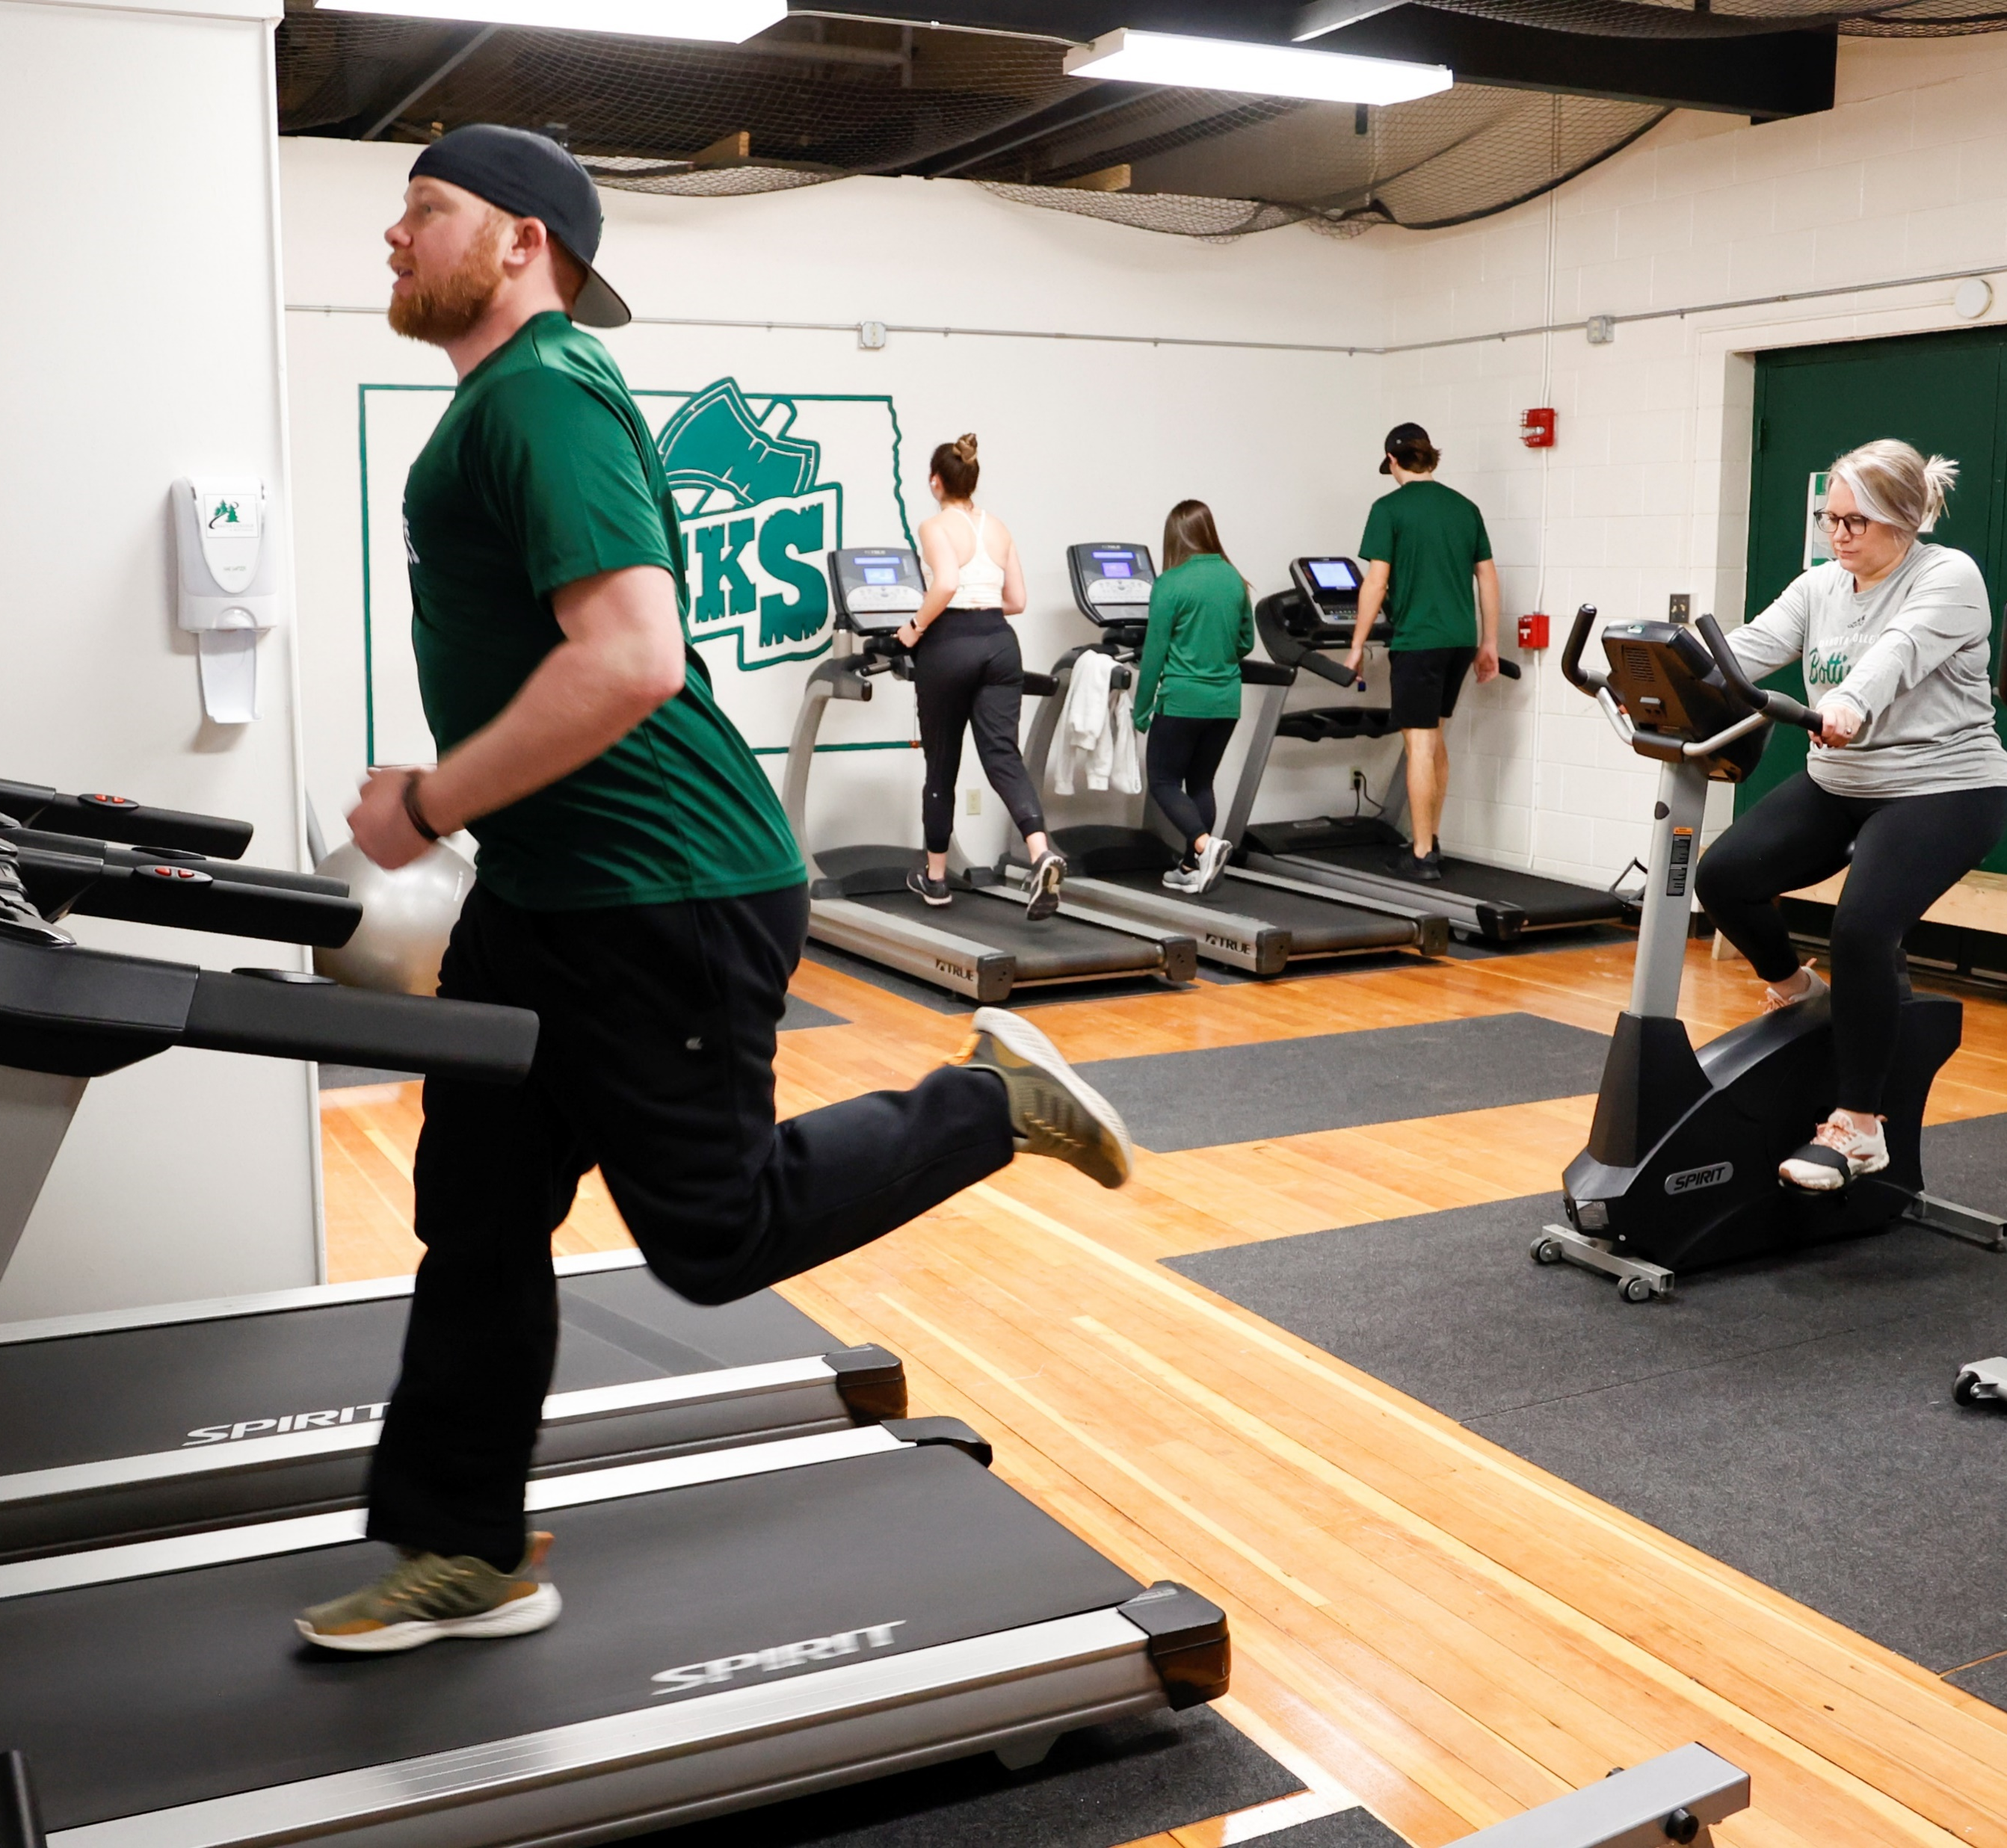
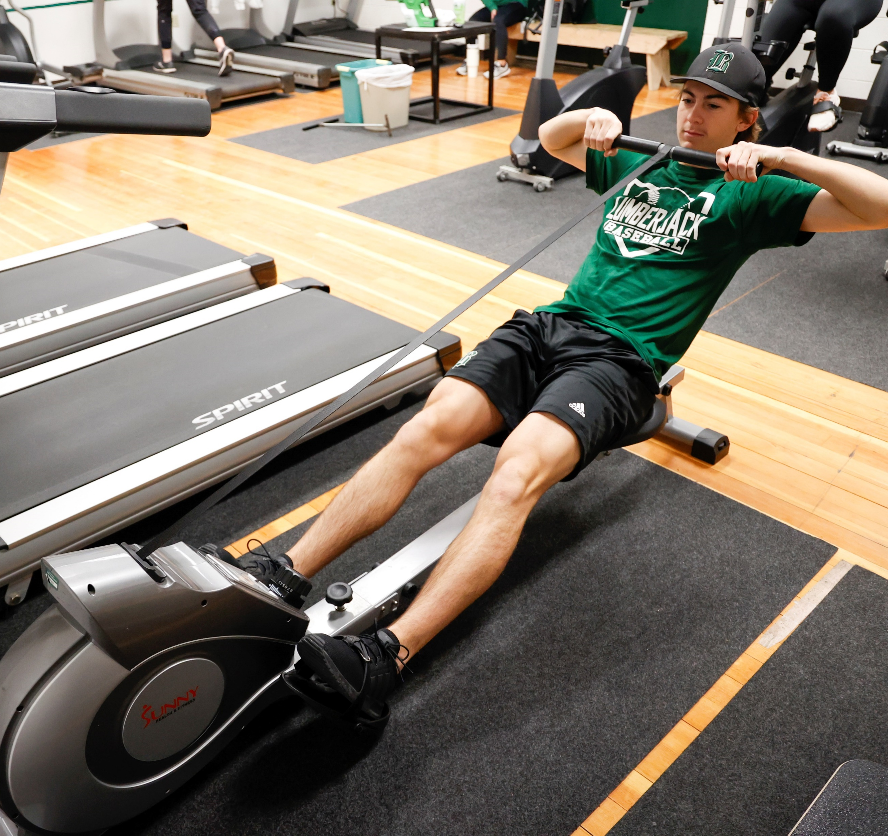
Employee Wellness
DCB supports a vibrant culture and encourages a healthy lifestyle for its community.
Fitness pass is free to access the gym, cardio room, sauna, weight room, and racquetball court as available.
Optional fitness pass may be purchased at a reduced price for spouse or dependent (over 18) to access the gym, cardio room, sauna, weight room and racquetball court as available.
Get rewarded for getting healthy with the NDPERS Dakota Wellness Program. A $250 Benefit is available to all eligible members and their covered spouses participating in the NDPERS group health insurance plan. This benefit is taxable as established by the Internal Revenue Service (IRS).
Dakota Wellness Program

Slide 19


Retirement Plans
MSU offers two retirement plans depending on an employee’s classification:
North Dakota Public Employee Retirement System (NDPERS)
  Employees eligible for this plan are classified staff.
    Participants are automatically enrolled.
    All staff employees (Bands 4000-7000) participate in NDPERS
Teachers Insurance Annuity Association (TIAA)
  Employees eligible for this plan are faculty and administrative/professional.
    Participants must enroll at https://www.tiaa.org/ndus
    Faculty and Administrators (Bands 0000-3000) participate in TIAA
DCB offers supplementary voluntary plans including 403B and 457 deferred compensation plans.

Slide 20

NDPERS Plan
NDPERS - Defined Benefit Plan
Employee Contribution | 3.00%
DCB Contribution | 12.26%
Total Contribution | 15.26%
NDPERS
The plan for staff is a Define Benefit Hybrid Plan.
For detailed information about this plan, please refer to the NDPERS Retirement Plan.
The lifetime, monthly benefit is calculated based on a formula.
NDPERS offers numerous training programs throughout the year, including one-on-one consultations.
Each eligible new hire receives notifications and personal plan comparisons. For questions, contact NDPERS at 701-328-3900.
NDPERS offers a voluntary/supplemental 457 Deferred Compensation plan that allows pre-tax deferrals subject to annual federal limits.
NDPERS provides a Quick Enrollment option for the NDPERS Companion Plan administered by TIAA.
Employees are required to enroll online at NDPERS
Plan Handbook Overview

Slide 21
TIAA Plan
TIAA Contribution by Years of Service | Employee Contribution | MSU Contribution | Total Contribution
Less than two years | 3.5% | 7.5% | 11%
Years 3 through 10 | 4.5% | 12.5% | 17%
More than ten years | 5.0% | 13.0% | 18%
(Non-broadbanded executives and administrators, professors, and associate professors start at the rate for years 3 through 10. Years of service may include years with DCB, years with TIAA at a different institution, and previous years with the NDPERS defined benefit plan or the Teacher’s Fund for Retirement (TFFR).)
TIAA
The plan for faculty and administrative/professional staff is a 401(a) defined contribution plan.
In this plan, employees may select from different investment options, passive or active.
Participants in this is plan make contributions which are matched according to years of service.
Participants are vested immediately.
Voluntary/Supplemental plans, including 457 and 403b, allow pre-tax deferrals subject to annual federal limits.

Slide 22
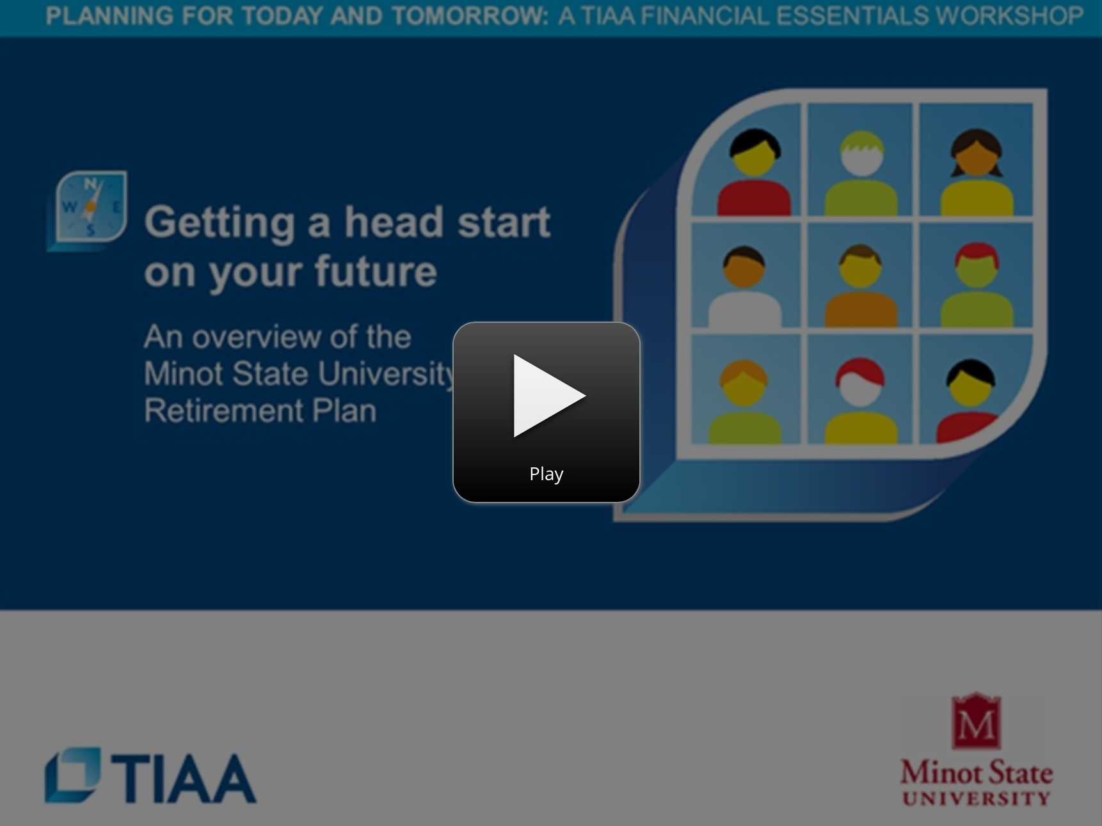
TIAA Intro Video
Watch TIAA Introduction
Need additional help with retirement planning?
You call 800-732-8353, weekdays, 8 a.m. to 8 p.m. (ET) to schedule a one-on-one session with a TIAA Financial Consultant.
Or you can schedule online at TIAA.or/schedulenow.
Check the HR Homepage for live and on-demand webinars as well as other retirement planning events.
https://www.brainshark.com/tiaa-cref_direct/MinotState

Slide 23


Policy & Procedure
NDUS Human Resource Policy Manual
DCB Employee Handbook
Probationary Period:
All new staff are on a probationary employment period for their first 6 months.
  Supervisors have the discretion to extend the probationary period if necessary.

Slide 24
Equal Opportunity Employer
DCB prohibits, harassment, discrimination and/or retaliation in admissions, employment and access to college programs and activities on the basis of race, color, religion, age, gender expression/ identity, sex, sexual orientation, genetic information, marital status, national origin, citizenship status, physical or mental disability, pregnancy, public assistance status, spousal relationship to current employee, status as a U.S. veteran, participation in lawful, non-conflicting to core interests, activity off DCB’s premises during nonworking hours, or other protected characteristics under federal, state, or local law.
Anti-Harassment
DCB prohibits all forms of harassment and retaliation for protected activity (such as reporting alleged harassment or providing information related to a grievance). MSU is committed to taking action to (1) stop it; (2) remedy its effects; and (3) prevent its recurrence. Any employee who feels that they have been subjected to prohibited harassment is encouraged to report the situation to before it becomes severe or pervasive.

Slide 25
Workplace Policies
Americans With Disabilities Act
DCB complies with the Americans with Disabilities Act of 1990 and promotes an inclusive environment while preventing discrimination in employment and education, whether physical or mental, of qualified individuals with or without a reasonable accommodation.
Code of Conduct
DCB supports an educational environment where all members of the campus community contribute to a positive work culture through professionalism, courtesy and mutual respect. Each employee is expected to conduct himself/herself in a businesslike manner and in accordance with the highest levels of honesty, integrity and ethical behavior when conducting University business. MSU does not tolerate harassment, discrimination, retaliatory behavior, or sexual misconduct in violation of federal or state law, or applicable system policy.
Conflict of Interest:
A conflict of interest arises when a DCB employee is involved in an activity, commitment, or interest that adversely affects, compromises, or is incompatible with the obligations that the employee has to DCB.

Slide 26
Workplace Policies
Drug Free Workplace
DCB prohibits the use, possession and/or sale of alcoholic beverages or illegal drugs in classrooms, laboratories, bathrooms, offices, residence halls, university housing units, athletic facilities, university vehicles, other campus building areas, public campus areas or in outdoor campus areas.
Workers Compensation
DCB recognizes that the safety, health and well-being of its employees is of utmost importance. To this end, a priority will be placed on the prevention of accidents and occupationally incurred illnesses. It is the responsibility of every employee to work in a safe manner, and to intervene when others are performing in an unsafe manner.
If you are injured or may have an injury, make sure to file a First Report of Injury with WSI within 24 hours of the incident.

Slide 27
Title IX and Sexual Harassment
Sexual Harassment
Sexual harassment is a form of discrimination that violates Title VII of the Civil Rights Act of 1964. Sexual harassment consists of unwelcome sexual advances, requests for sexual favors, and other verbal or physical conduct of a sexual nature that explicitly or implicitly affects an individual’s employment, unreasonably interferes with an individual’s work performance, or creates an intimidating, hostile, or offensive work environment. Employee training is mandatory on an annual basis.
Title IX
Dakota College at Bottineau adheres to all federal, state, and local civil rights laws prohibiting sex-based harassment in employment and education. The University does not discriminate in its admissions practices (except as permitted by law), in its employment practices, or in its educational programs or activities on the basis of sex/gender.
Title IX Coordinator
Laura Halvorson | laura.Halvorson@dakotacollege.edu | 701-228-5680

Slide 28
Payroll
Pay Day:
Employees are paid twice a month, on the 15th and the last day of the month. If payday falls on a weekend, then the payday is the last workday prior to the weekend. There is a two-week lag in payroll. If hired on the first of the month, the first paycheck would be on the last day of the month. Paychecks are processed via direct deposit.
Time Reporting:
Both exempt and non-exempt employees use TLAB. Non-exempt employees must record any overtime work for the week, which is then approved by the supervisor. Both exempt and non-exempt employees request time away from work (sick, vacation, funeral, etc.) in the system. The supervisor will receive a notification and process the approval.

Slide 29
Holidays
The State of North Dakota observes the following ten holidays:
New Year’s Day Martin Luther King Day
President’s Day Good Friday
Memorial Day Independence Day
Labor Day Veteran’s Day
Thanksgiving Day Christmas Day

Slide 30
Leave Benefits
Sick Leave
All staff employees earn sick leave at a rate of 12 days per year. It is accrued in the same manner as annual leave. All sick leave accrues without limit.
Annual Leave
Annual leave accrues at eight hours a month for the first 3 years, 10 hours in the 4th through 7th years, 12 hours in the 8th through 12th years, 14 hours in the 13th through 18th years and at 16 hours over 18 years of service. (North Dakota University System policy 6). Eligible upon employment.
Leave Type | Years of Service | Days/Year
Sick | All Years of Service | 12
Annual | 1-3 Years | 12
 | 4-7 Years | 15
 | 8-12 Years | 18
 | 13-18 Years | 21
 | 18+ Years | 24

Slide 31
Brand Guidelines
GRAPHIC STANDARDS To provide campus personnel guidelines to help ensure consistent application of the Dakota College at Bottineau identity. Projecting a unified visual identity involves more than simply creating and implementing a logo. Brand Guidelines provide a sound, flexible structure for using logos, color, and typography unique to DCB. By consistently following brand guidelines, DCB’s visual identity will become established and recognized. Failure to properly use these elements reduces our ability to effectively communicate with DCB’s many audiences and diminishes the identity’s value. EMAIL COMMUNICATION AND SIGNATURES Email communication is a presentation of official Dakota College at Bottineau correspondence. To maintain consistent branding standards across all forms of DCB communication, it is recommended that faculty and staff use a DCB email signature provided. In addition, an email must preserve the white background and not include background graphics. Official email signatures of DCB employees must not include quotes, custom fonts, photos, or links. Brand Guidelines available on the DCB website

