Slide 1

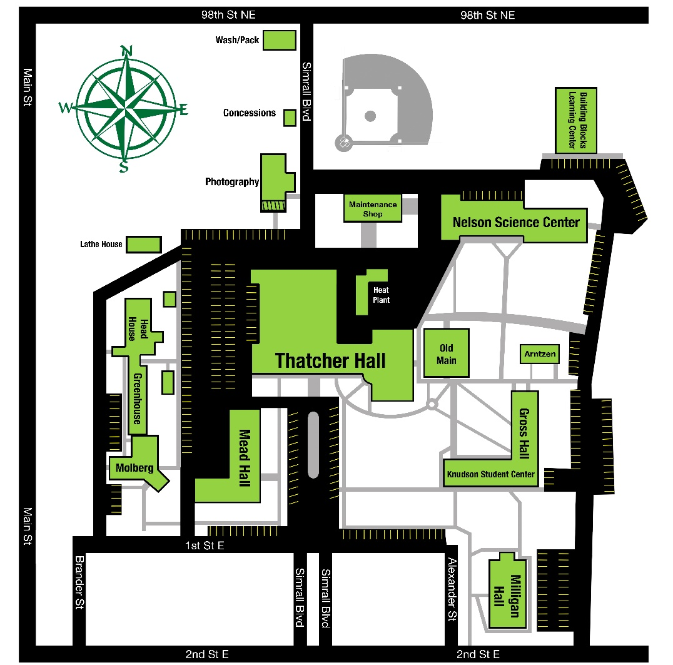

New Employee Orientation
Employee Self-Service
- Office of Human Resources -
2023 - 2024

Slide 2


Employee Self-Service (ESS)
The DCB self-service portal provides employees with access to their information including personal data, payroll, compensation, benefits information and the leave request system.
Log in to the Human Resource Management System (HRMS) using your system- issued User ID and Password.
Duo Two-Factor Authentication is required to access your account.
If you have any questions, please contact the Payroll & Benefits Office at available via email or
Teams marlene.Hargrave@dakotacollege.edu or Human Resources, Sandy Hageness located in
DCB Thatcher Hall #111 | sandy,.hageness@dakoatacollege.edu | 701-228-5480

Slide 3

Duo Two-Factor Authentication (DUO)
If this is the first time you are accessing your account Duo Two-Factor Authentication will need to be set up.
Two-factor authentication protects your university account by adding a second layer of digital security. All DCB employees are required to use Duo Two-Factor Authentication. Phone numbers in the HRMS system are automatically enrolled in DUO.
https://www.dakotacollege.edu/student-life/computer-services/duo-mobile
If you have any questions, please contact Jacob Nelson Information Systems Specialist
located n Thatcher Hall, Room 209 | 701-228-5429 | jacop.p.nelson@dakotacollege.edu

Slide 4
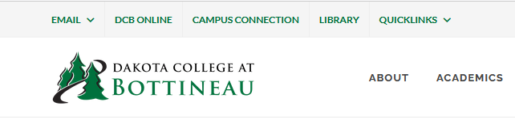
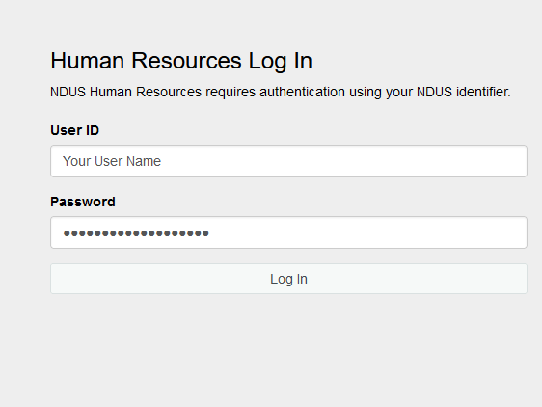
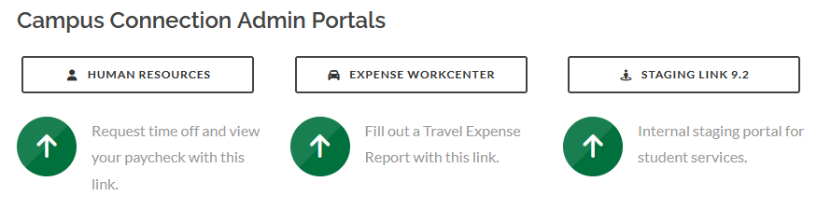
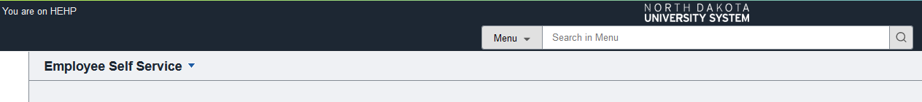
Employee Self-Service (ESS)
To access the Employee Self-Service portal, go to our website www.dakotacollege.edu and click on Quick Links–Faculty & Staff–Human Resources www.dakotacollege.edu/faculty-and-staff
1
3
2
4

Slide 5
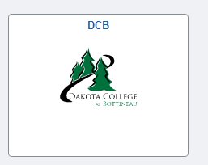
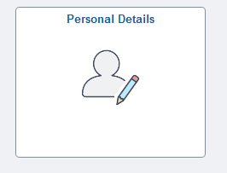
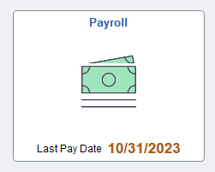
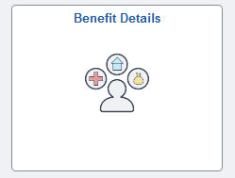
Employee Self-Service (cont.)
Example of some of the categories you will find under each self-service link. Click on any of the links to view or update your information.
Dakota College eForms
Available Forms and Options
Complete a Tuition Waiver Form
View a Form
Update a Form
Evaluate a Form
Personal Details
Update Address
Contact Details
Emergency Contacts
Ethnic Groups
Disability
Veteran Status
Form I-9
Additional Information
Payroll
Paychecks
W-2/W-2c Consent
W-2/W-2c Forms
Direct Deposit
Tax Withholding
Benefit Details
View 1095-C
Form 1095-C Consent

Slide 6
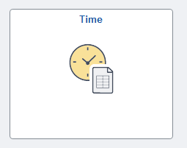
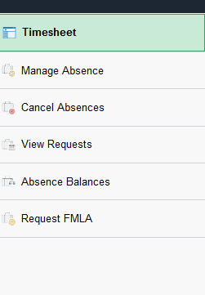
ESS Absence Management
Absence Management is a module in HRMS self-service used by all employees who earn leave to view leave balances and request time off. This applies to all types of leave: Annual, Sick, Dependent Sick, Comp Time, Jury Duty, Military and Funeral.
An absence can be requested for an event that occurred in the past (e.g. a sick day) or for an event to occur in the future, such as annual leave. All absences should be entered by the employee, and approved by the supervisor, no later than the end of the pay period in which the absence occurs.
Choose the Time tile to enter hours, manage and request leave and request FMLA.
1

Slide 7
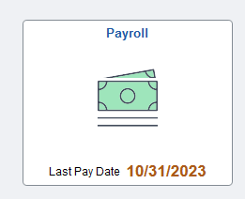
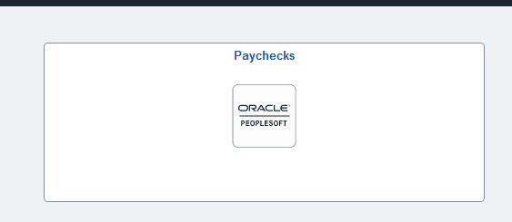
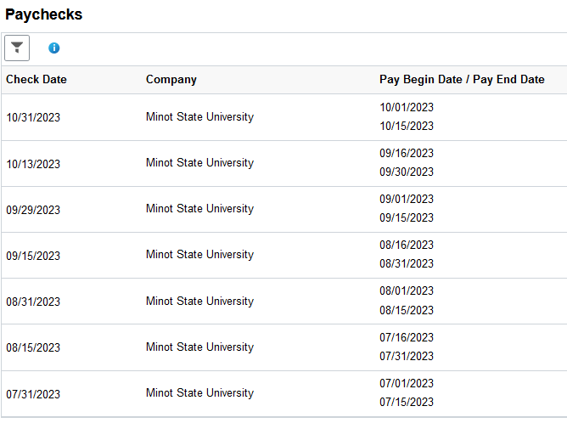
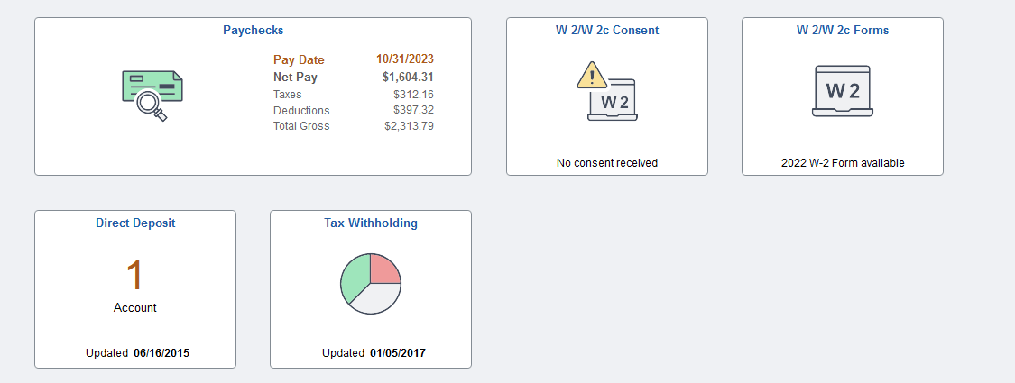
ESS Paycheck / W2
To View and/or Print Your Paycheck To View and/or Print Your W-2, Update Direct Deposit
In Employee Self Service click on Payroll
Paychecks
Choose the paycheck you’d like to view/print
In Employee Self Service click on Payroll
W-2 Forms or select Direct Deposit
View and print or update from here

